Slide 1
Dotnet CLI
Sarita Lad
DATE

Slide 2
What is CLI?
Command Language Interface:
1 Name
dotnet - The generic driver for the .NET CLI.
dotnet [--version] [--info] [--list-runtimes] [--list-sdks]
dotnet -h|--help
Description
The dotnet command has two functions:
It provides commands for working with .NET projects.
For example, dotnet build builds a project. Each command defines its own options and arguments. All commands support the --help option for printing out brief documentation about how to use the command.
It runs .NET applications.
You specify the path to an application .dll file to run the application. To run the application means to find and execute the entry point, which in the case of console apps is the Main method. For example, dotnet myapp.dll runs the myapp application. See .NET application deployment to learn about deployment options.

Slide 3
Dotnet new <template> command
Dotnet new console –name myconsole
Name
dotnet restore - Restores the dependencies and tools of a project.
In most cases, you don't need to explicitly use the dotnet restore command, since if a NuGet restore is necessary, the following commands run it implicitly:
dotnet new
dotnet build
dotnet build-server
dotnet run
dotnet test
dotnet publish
dotnet pack

Slide 4
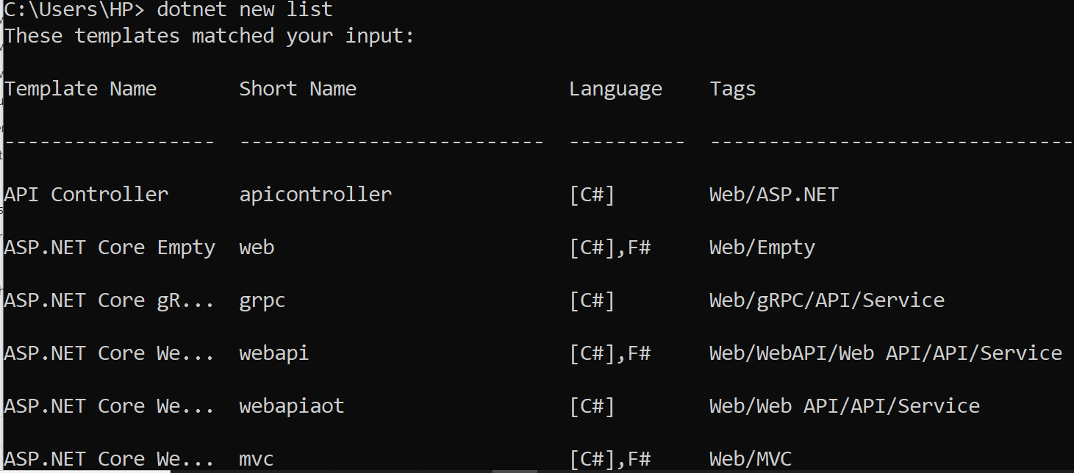

Slide 5
Thank You

